Slide 1
How Does Contract Design Affect the Uptake of Microcredit among the Ultrapoor? Experimental Evidence from River Islands of Northern Bangladesh Kazushi Takahasi (Sophia University), Abu Shonchoy (IDE-JETRO) Seiro Ito (IDE-JETRO) and Takashi Kurosaki (Hitotshubashi University)
IER, Hitotsubashi University
Lunch Seminar
March 15th, 2017

Slide 2
Outline of the presentation
Background
Motivation
River Island areas and the reality
Experimental Design
Issues and Complexity faced in the field
Data
Estimation
Conclusion

Slide 3
Background
Many existing studies point out that the ultrapoor, have been excluded from microcredit
See Morduch, 1999; Navajas et al., 2000; Duong and Izumida, 2002; Copestake et al., 2005; Cuong 2008, to name a few.
Why Ultrapoor are excluded from the Microcredit?
Demand Side Constraints:
heterogeneity in returns to credit: returns are significantly different with client’s entrepreneurial ability and their household wealth (de Mel et al. 2008)
Microcredit impacts on income are positive only for households with an existing business or those who manage to start business (Banerjee et al. 2013)
Even targeted ultra poor programs result in neither significantly greater total income nor asset accumulation of its beneficiaries (Morduch et al. 2013)
Ultrapoor are typically less experience or less willingness to participate in self-employed activities due to risk aversion.

Slide 4
Background
Supply Side Constraints:
Default risk of the ultra poor: Ultra poor would demand more cash for making daily ends meet rather than for productive investment to expand business.
Moral hazard: ultrapoor are more mobile than the moderately poor and non-poor because of their lack of immobile assets.
The PROBLEM:
Ultrapoor are not being targeted, they are largely excluded from typical microcredit program
Ultrapoor have to rely on informal borrowing, either from loan sharks or social networks.
Typical Microcredit design may not be suitable for ultrapoor.

Slide 5
Research Motivation
We do not know what type of credit is preferred by ultra poors?
Small Loan? (Hulme 1999)
Larger grace period (Field et al. 2013)
Larger loan to have a lumpy investment to get them out of poverty ((Galor and Zeira, 1993; Lybbert and Barrett, 2010)
Research Question:
What type of credit and contract design is preferred by the ultra poor?

Slide 6
Research Area
The study has been conducted in the river island areas, known as “Char” in northern Bangladesh in Gaibandha and Kurigram districts
Chars are formed by sediments and silt depositions, and are prone to cyclical river erosion and floods.
Chars are not stable in its size and even in its existence.
Chars absorb the habitants of ultrapoor households who are forced to relocate as a desperate attempt for survival across islands due to river erosion and floods.
Seasonal floods periodically happen during the wet seasons as monsoon.

Slide 7
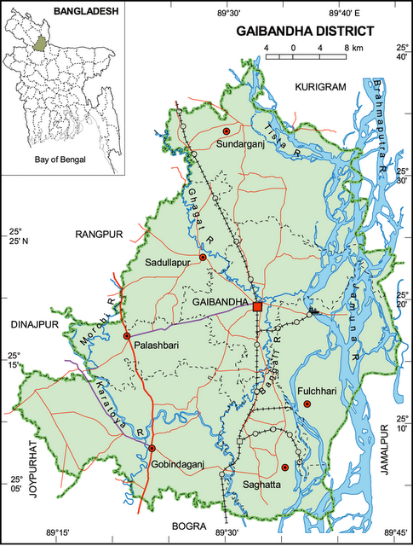
RCT intervention with an NGO
Our counterpart NGO:
Gana Unnayan Kendra (GUK)
Local NGO based on Gaibandha District.
Targeted at women, ultrapoor, and char areas
Project target area:
Microcredit-virgin chars in Gaibandha District and Kurigram District

Slide 8
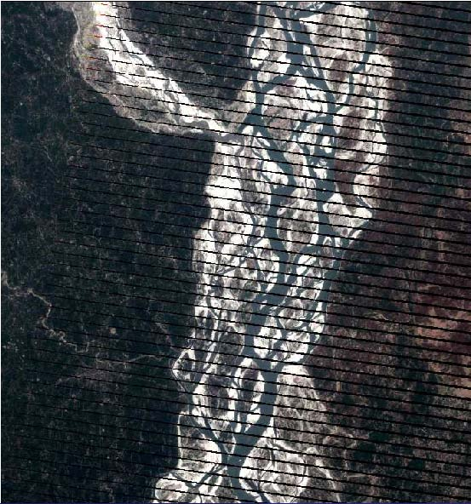
Topographic characteristics of Chars (River Islands)
Google Maps

Slide 9
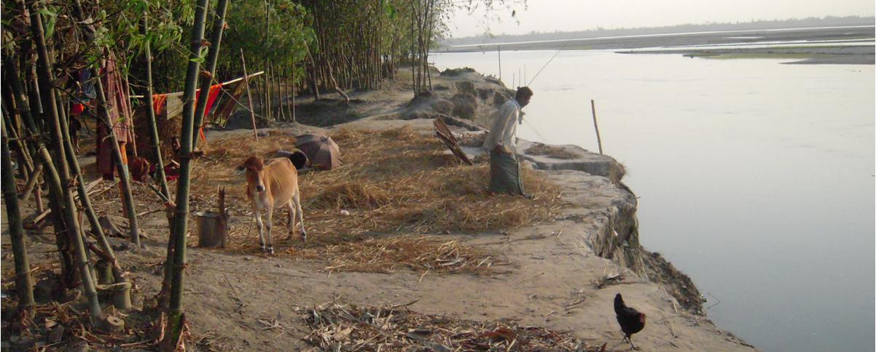
Char Livelihood

Slide 10
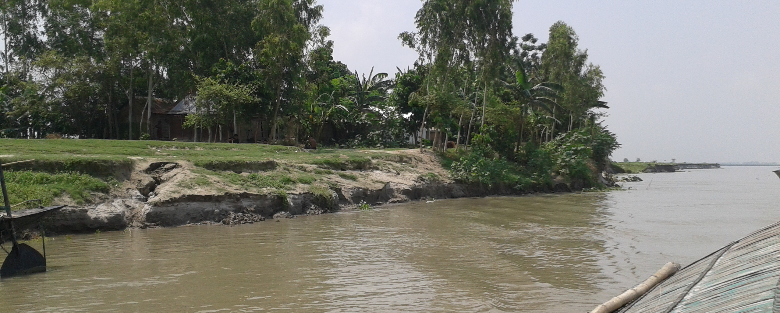
A typical Char in Gaibandha

Slide 11
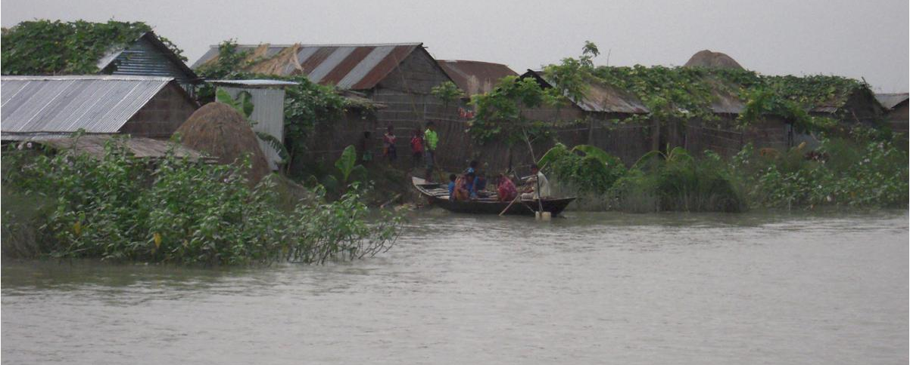
Flood in the Char areas

Slide 12
Experimental Design
In each village, a Samity (CBO) is formed with 20 women members
Each Shamity (CBO) was created with 14 ultra poor and 6 moderate poor households.
Village Level Randomization: Each Char village as assigned to one of the treatment arms.
Within Village Randomization: Within the village Shamity, 10 members, 7 from ultra poor and 3 from moderate poor were selected to receive credit immediately. Other have to wait a year to be eligible for credit.
Once this two-level randomization was completed, we announced the randomization results to our group members.

Slide 13
Experimental Design
Four treatment arms.
Regular microcredit (RC): Typical Microcredit. Members of the group will receive 5,600 taka. Weekly loan repayment of 125 taka after two weeks. Contract maturity is within one year. Successful repayment will eligible two additional loan contract of equivalent amount.
Large credit, without a grace period (LC): Large credit of 16,800 taka with three years maturity. Weekly repayment of 125 taka starts after two weeks.
Large credit, with one year grace period (LC+GP): Same as before except the loan repayment starts after a year, with weekly repayment of 190 taka payable in 100 weeks.
In-kind credit, with one year grace period (IK+GP): Same as before, however in case of money, we have given an in-kind credit of cow, within the price range of 16,000 taka with loan repayment to begin after one year of the distribution. In addition, the members will receive fodder, training on cow rearing, regular VET and vaccination service, and marketing consultancy services from the GUK authority, worth 800 taka for the entire service given for three years.

Slide 14
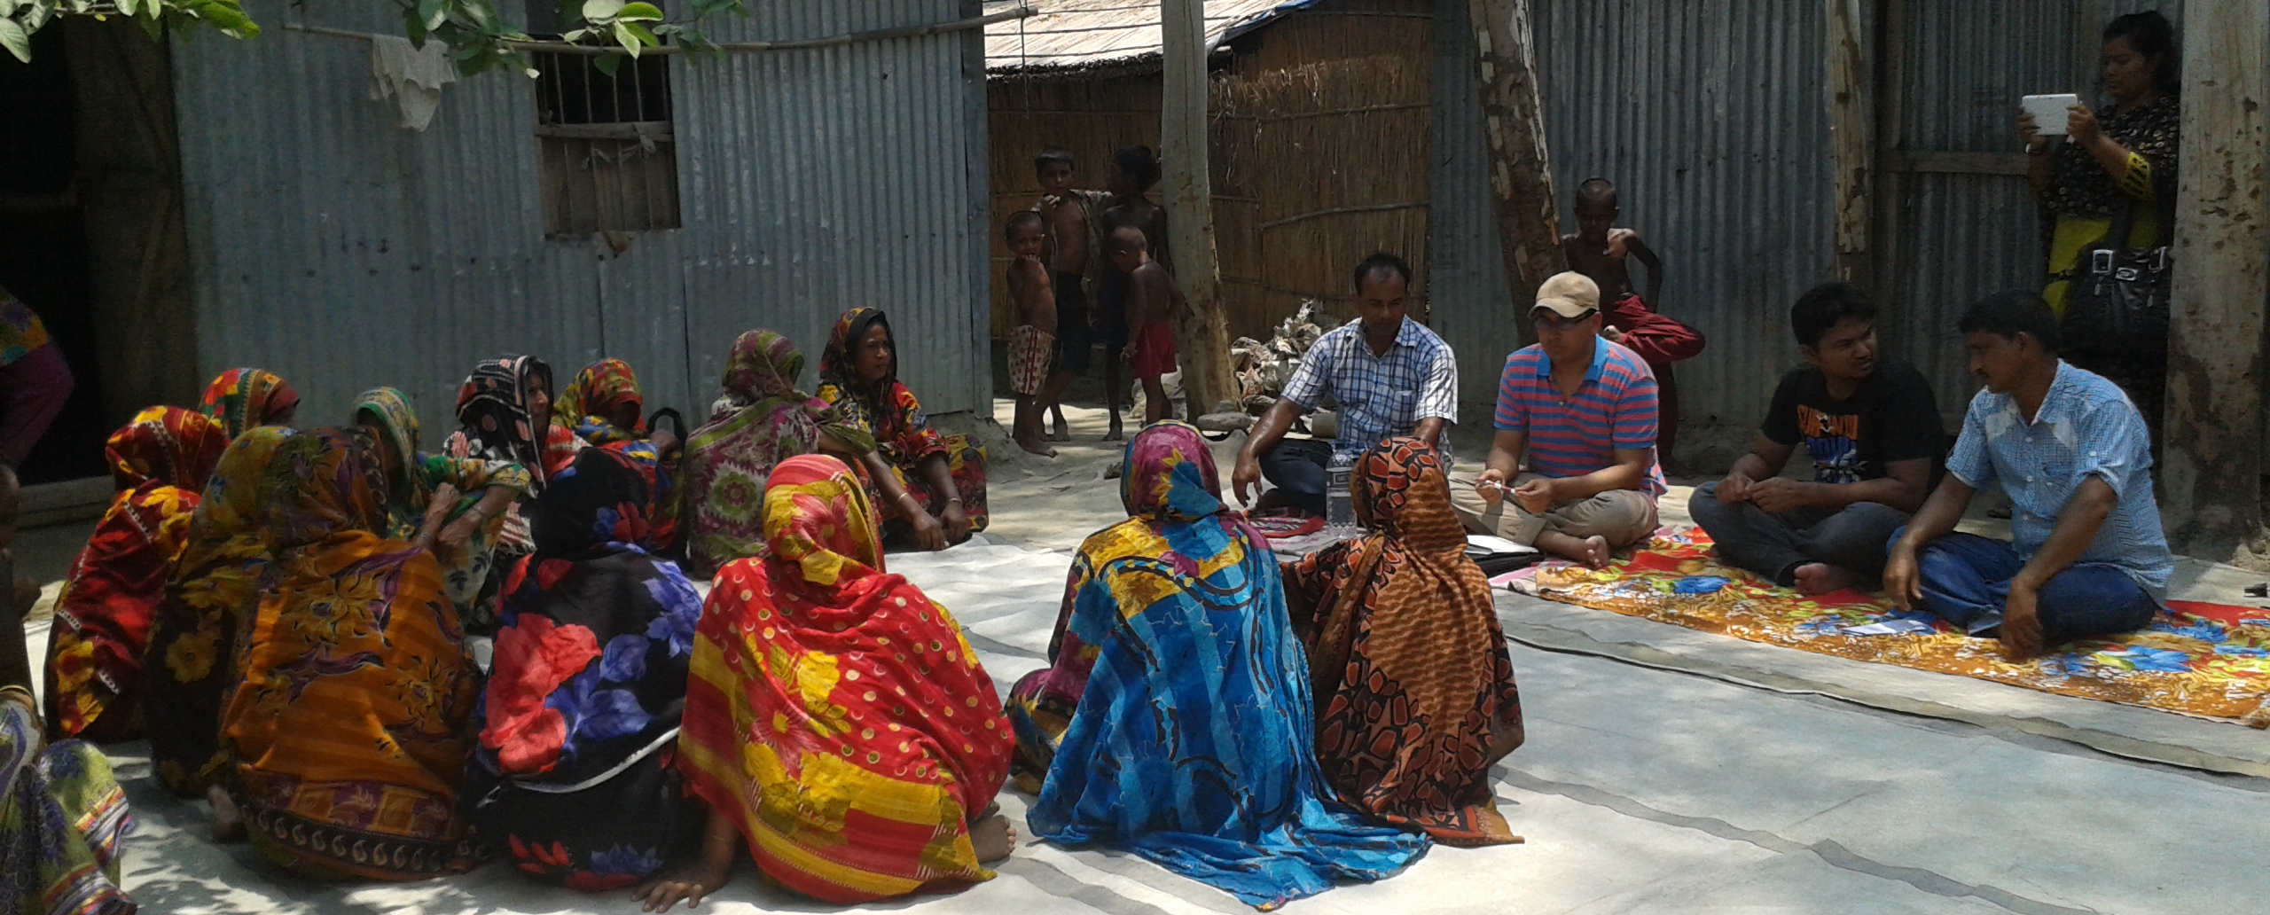
Credit Borrowing Groups in “Char” areas

Slide 15
Chronological Sequence of Acceptance
First Group members jointly decides whether or not to continue the credit activity under the assigned treatment arm. (Group Acceptance) 7 Groups rejected the Randomization offer.
Once the group makes a joint decision, individuals in the group can make a decision whether or not to continue (Individual) A total of 169 rejected the offer, 98 from the treatment and 71 from the control group
After the group formation, a few Chars got eroded (a total of 4 chars).
In the end we have 592 accepting to continue in the treatment and 619 in the control.

Slide 16
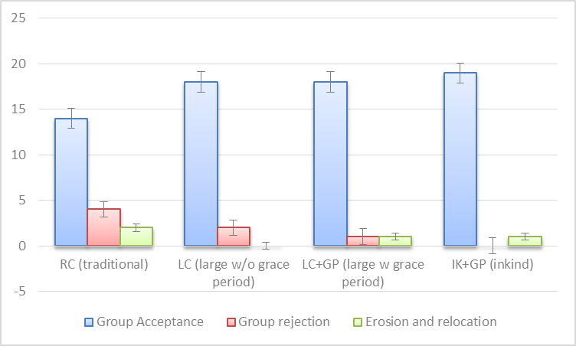
Group Level Acceptance/Rejection

Slide 17
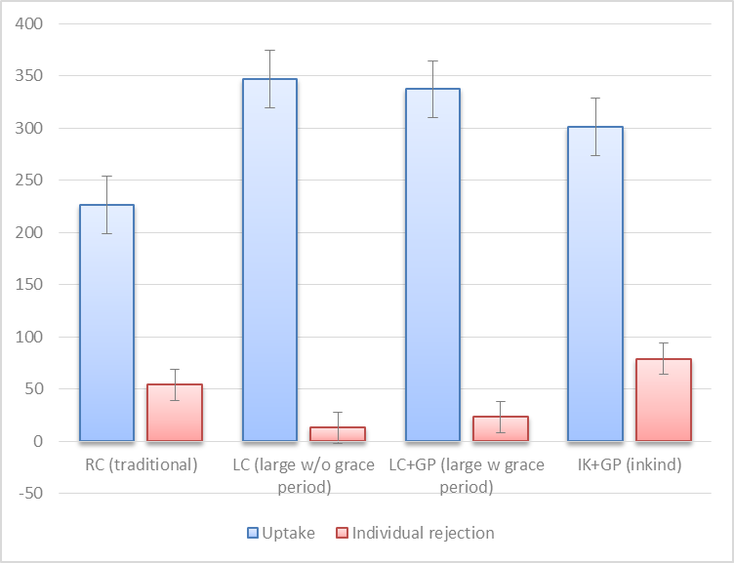
Individual Acceptance

Slide 18
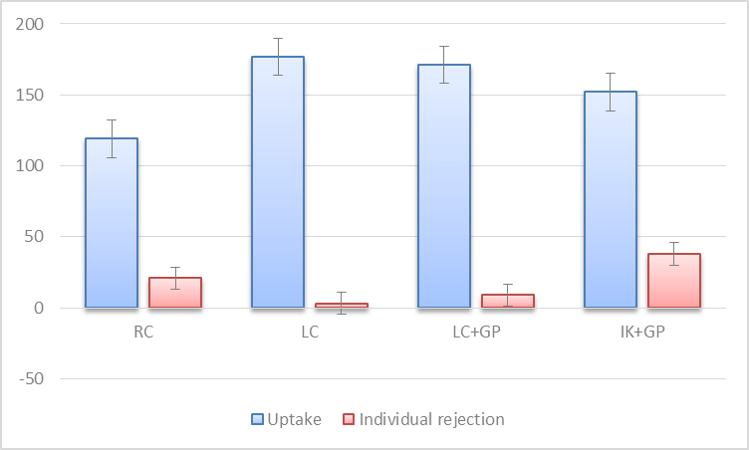
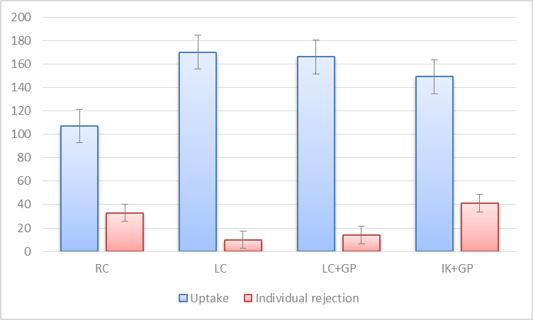
Individual Rejection Comparison Between treatment and control
Treatment
Control

Slide 19
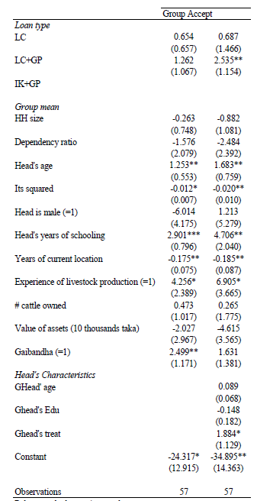
Determinates of Group level acceptance

Slide 20
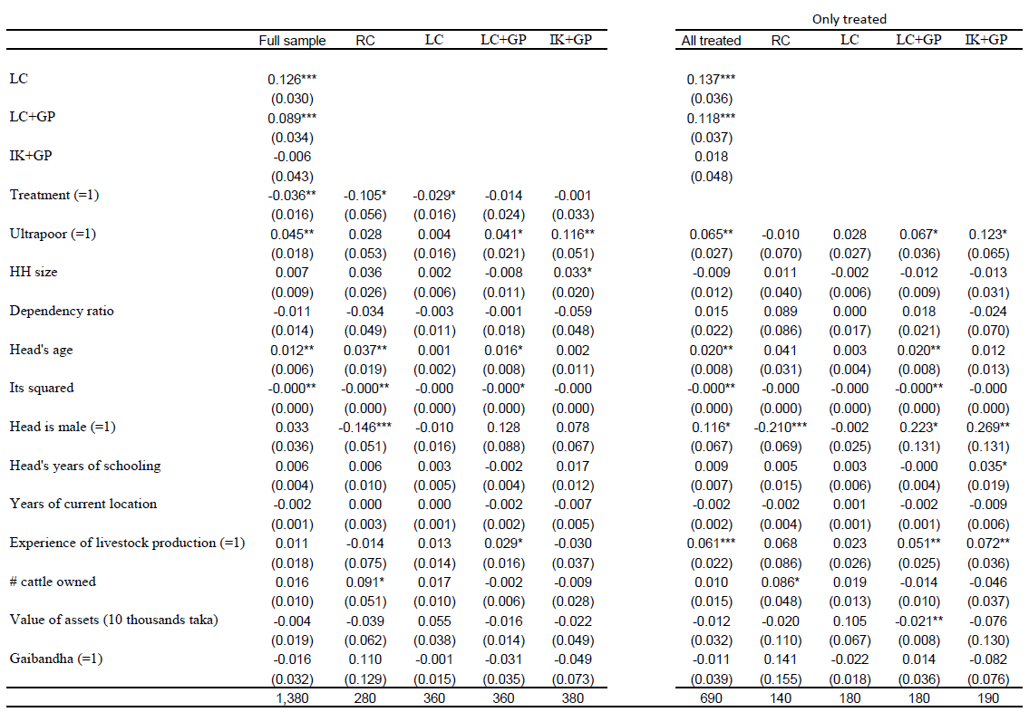
Determinates of Individual level acceptance, Conditional on Group Acceptance

Slide 21
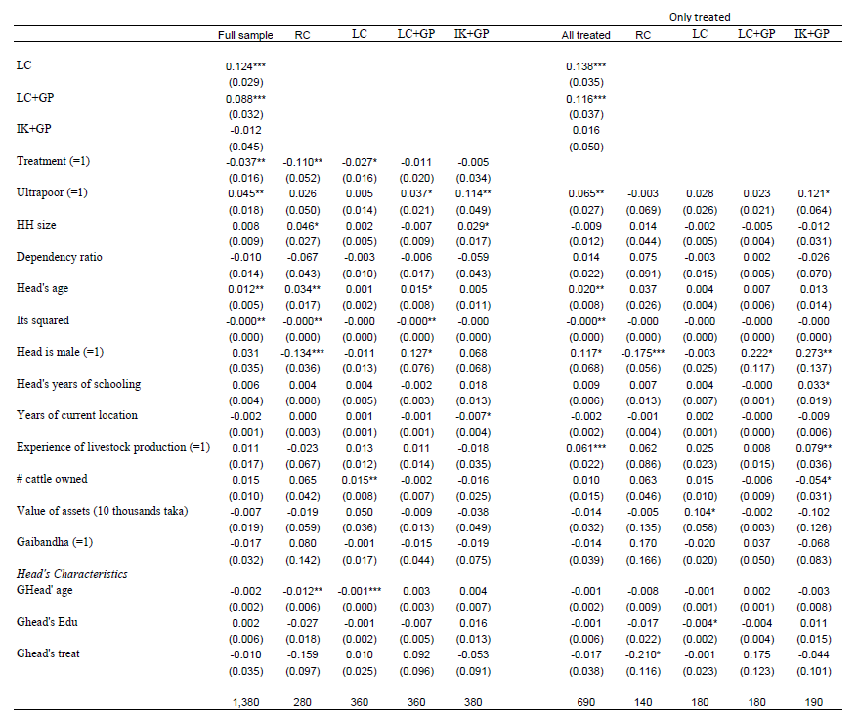
Determinates of Individual level acceptance, Conditional on Group Acceptance

Slide 22
Findings
The regression results showed that the uptake rate is significantly lower in the regular contract than the other three arms.
we found that large scale loans are preferred even by the ultrapoor who are usually believed to be risk-averse and demand small scale loans.
Although the overall uptake of the in-kind credit is significantly lower than equivalently-valued cash credit, the ultrapoor are more likely to accept the in-kind offer than the moderately poor.
It is also found that when offered, in-kind (cow) credit was more likely to be accepted if a potential borrower had previous experiences of livestock rearing, indicating the necessity of supplementary trainings for the ultrapoor.

Slide 23
Conclusion
One of the keys to attracting the ultrapoor is to provide a grace period in the repayment schedule, irrespective of whether credits are provided in cash or kind.
This paper provides evidence that a typical microcredit with one-year maturity without grace period is not attractive for the ultrapoor.
Our results suggest a possibility that microfinance institutions can expand their outreach to the ultrapoor by offering them longer maturity loans with convenient grace periods, without compromising the loan repayment schedules.

